Slide 1

Corporation
Chanchian Armin

Slide 2
1. Founding
GoldSrc Era – pre Half-Life

Slide 3
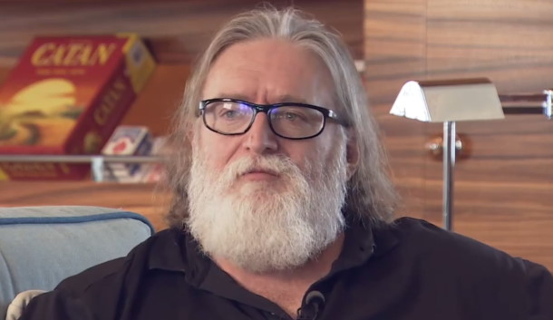
Gabe Newell
Valve was founded in 1996 by former Microsoft employees Gabe Newell and Mike Harrington. Newell had spent the prior 13 years at Microsoft developing Windows, including the Windows 95 port of Doom. Wanting to move onto a new venture using their shared wealth, Newell and Harrington founded Valve in Washington.

Slide 4

Half-Life
Valve's first product was Half-Life, a first-person shooter (FPS) with elements of the horror genre.The development was aided by access to the Quake engine by id Software; Valve modified this engine into their GoldSrc engine. After struggling to find a publisher, Valve eventually signed with Sierra On-Line. Half-Life was released in November 1998, and was a critical and commercial success. According to IGN in 2014, the history of the FPS genre "breaks down pretty cleanly into pre-Half-Life and post-Half-Life eras".

Slide 5
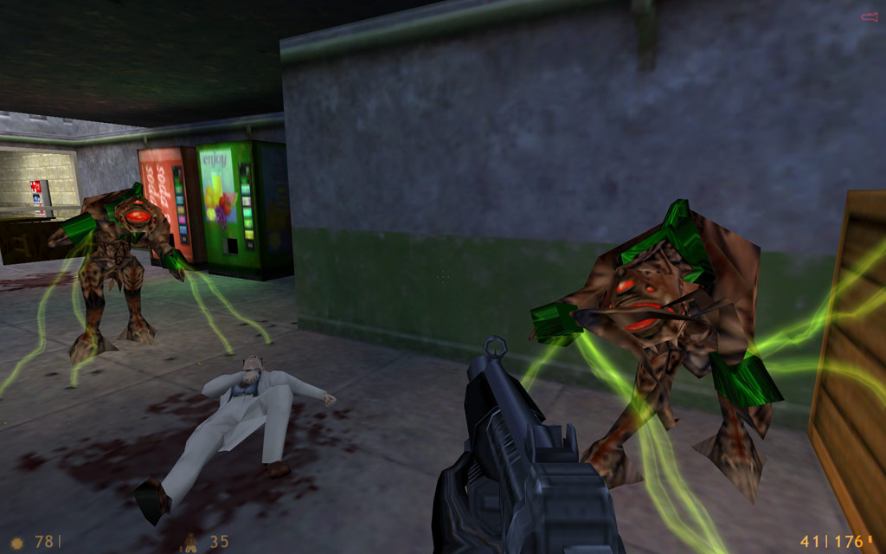
Preview of Half-Life 1

Slide 6

Rise of the modding community
Valve enlisted Gearbox Software to develop three expansions for Half-Life: Opposing Force (1999), Blue Shift (2001) and Decay (2001). Valve acquired TF Software in 1998, a group that had made the popular Team Fortress mod for Quake, and remade the mod for GoldSrc as Team Fortress Classic, released in 1999. Valve released the software development kit (SDK) for the GoldSrc engine, facilitating numerous user-created mods. Valve acquired the developers of one popular Half-Life mod, Counter-Strike, to create a standalone Counter-Strike game.

Slide 7
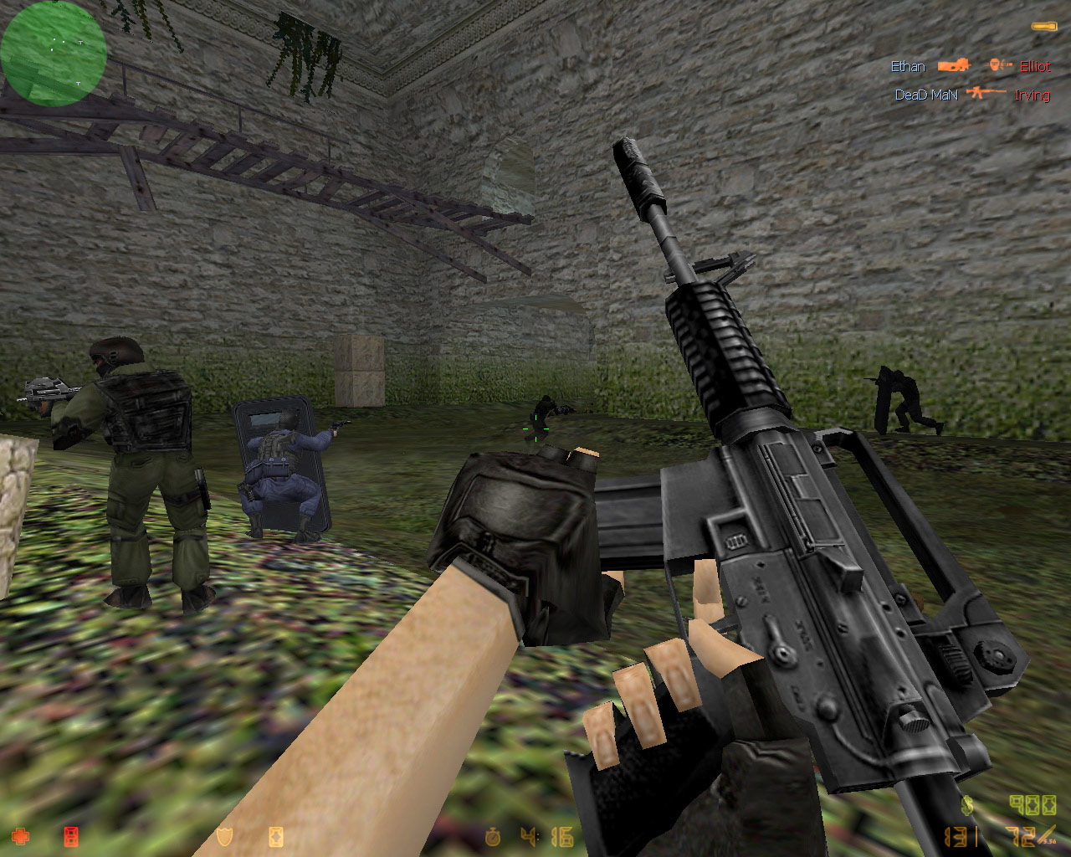
Preview of Counter-Strike

Slide 8
2. Continued expansion
Source Era – post Half-Life

Slide 9

Half-Life 2
Valve began developing Half-Life 2 six months after the release of the first Half-Life, using its new in-house engine, Source. With advanced physics systems and an increased focus on story and characters, it received critical acclaim upon its release in 2004; by 2011, it had sold 12 million copies.
Source distantly originates from the GoldSrc engine, itself a heavily modified version of John Carmack's Quake engine with some code from the Quake II engine. Carmack commented on his blog in 2004 that "there are still bits of early Quake code in Half-Life 2".

Slide 10
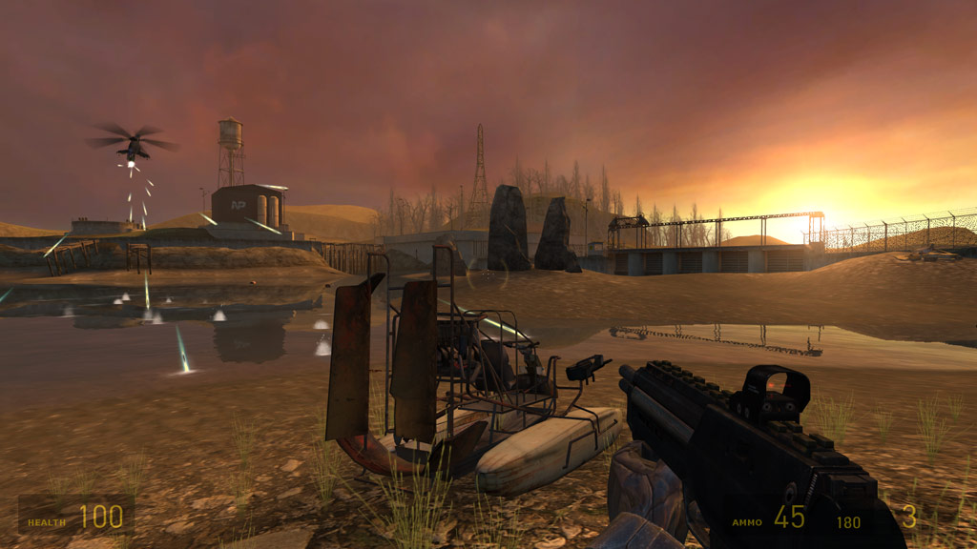
Preview of Half-Life 2

Slide 11

Steam
In 2002, Valve launched Steam, a digital storefront and delivery platform. Steam initially offered only Valve games, and was mandatory to install Half-Life 2, but became a publisher of third-party games. As Valve became its own publisher via Steam, it transitioned to a flat organization; outside of executive management, Valve does not have bosses, and the company uses an open allocation system, allowing employees to move between departments at will.

Slide 12
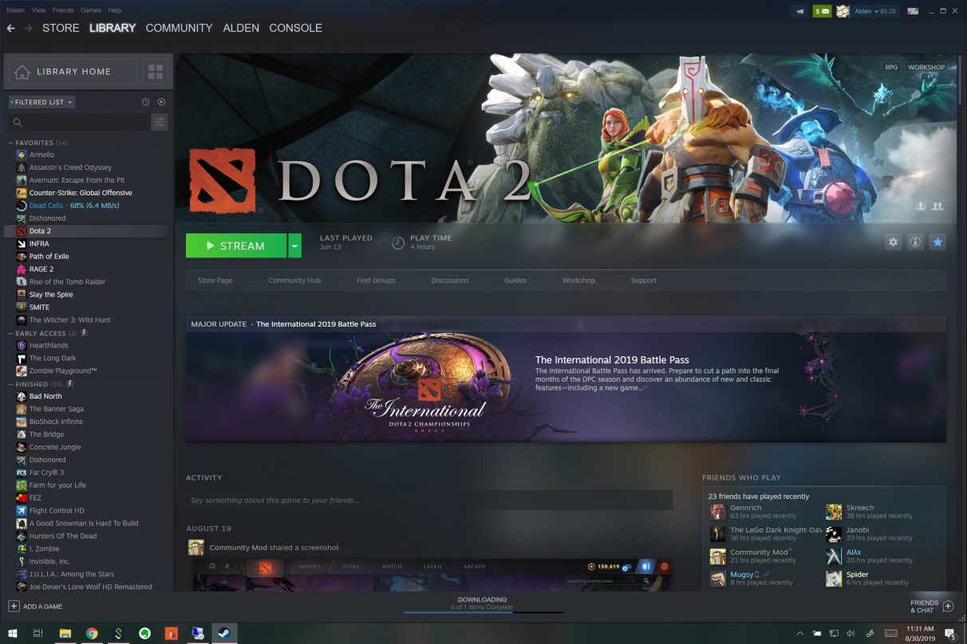
Preview of Steam

Slide 13


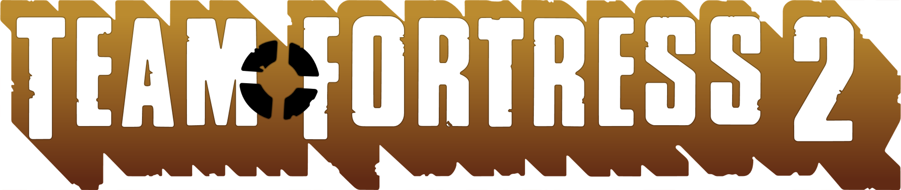
Multiple releases
After having taken years to develop Half-Life 2, Valve moved to episodic development, planning to release shorter games more frequently. Half-Life 2: Episode One, the first in a planned trilogy of games continuing the Half-Life 2 story, was released in 2006. Episode Two followed in 2007, alongside the multiplayer game Team Fortress 2, and the puzzle game Portal, developed from the student project Narbacular Drop.
In January 2008, Valve announced the acquisition of Turtle Rock Studios. They developed Left 4 Dead and Left 4 Dead 2 while associated with Valve. Turtle Rock Studios later spun out of Valve again in March 2010.

Slide 14
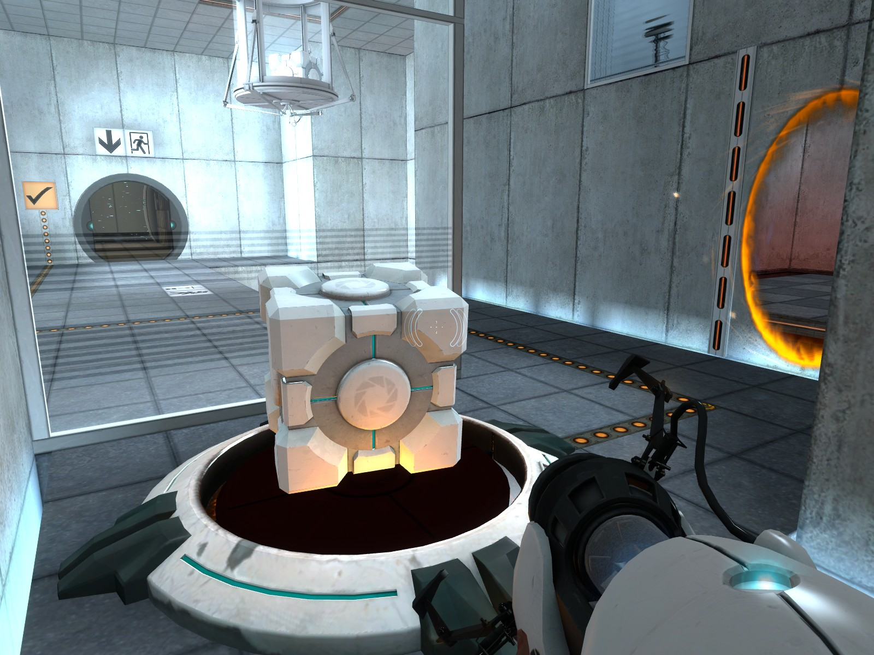
Preview of Portal 1

Slide 15

Failed transition to services
In 2010, Valve hired IceFrog, the developer of Defense of the Ancients, a Warcraft III mod. IceFrog led the development of a sequel not associated with the Warcraft elements, Dota 2, released in 2013.
Valve released Portal 2 in 2011 and Counter-Strike: Global Offensive in 2012.
In 2015, Valve released the Steam Machine, a line of gaming computers, which sold poorly. Media commentators speculated that Valve's transition to service provider with Steam, which generated an estimated $3.4 billion in 2017, had driven it away from game development. Many players grew frustrated in anticipation of a new Half-Life game.

Slide 16
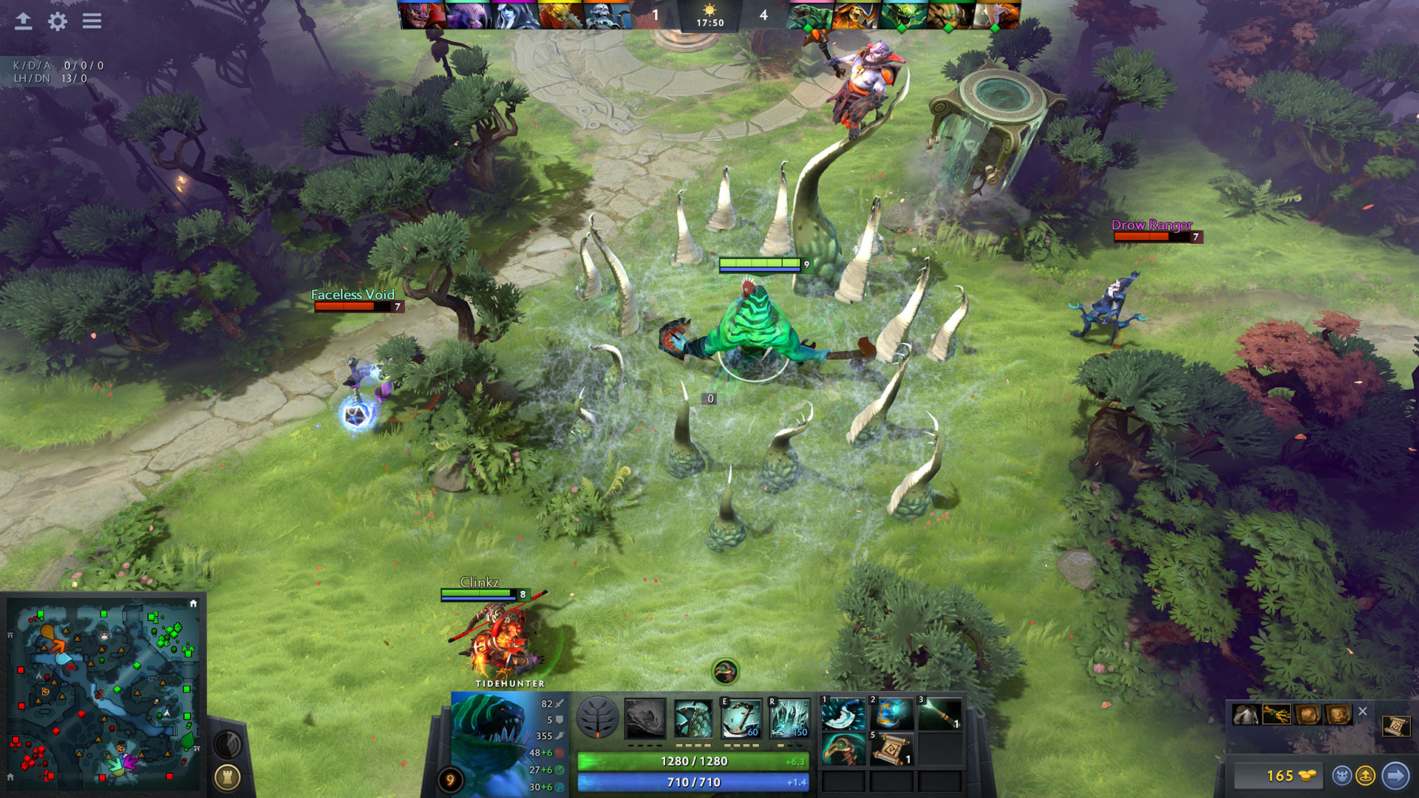
Preview of Dota 2

Slide 17
2. Reorganization
Source 2 Era

Slide 18

Source 2, VR and Half-Life: Alyx
Valve announced the Source 2 engine in March 2015 and ported Dota 2 to it that September. That year, Valve collaborated with the electronics company HTC to develop the HTC Vive, a VR headset released in 2016. Valve experimented with VR games, and in 2016 released The Lab, a collection of VR minigames.
In June 2019, Valve released its second-generation VR hardware, the Valve Index. Subsequently, they’ve released Half-Life: Alyx, a VR game. It received acclaim and was described as VR's first killer app.
Valve announced the Steam Deck, a portable gaming PC that runs off SteamOS Linux, in July 2021.

Slide 19
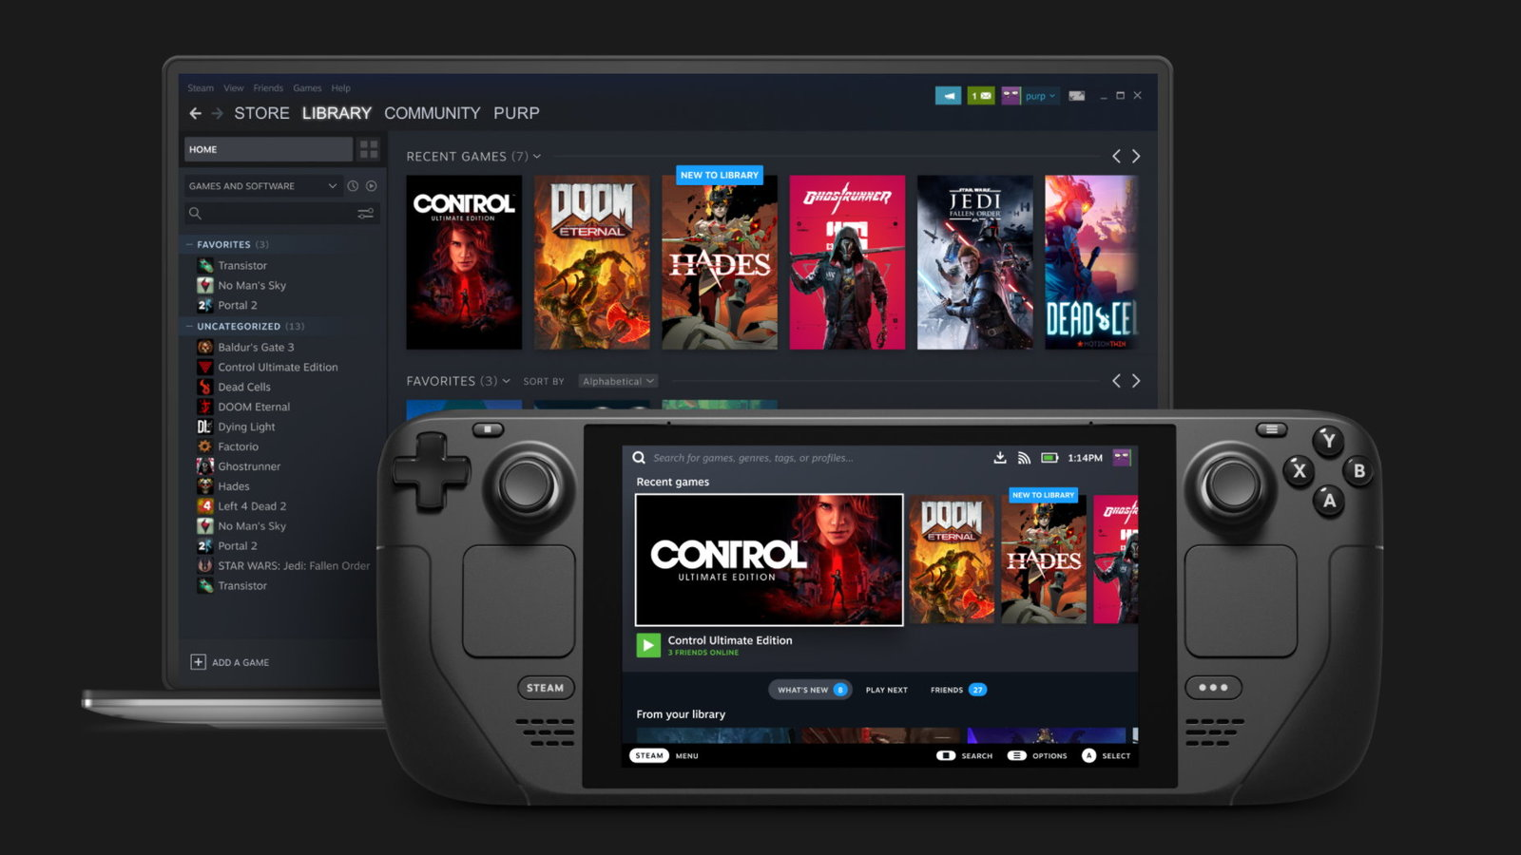
Preview of Steam Deck

Slide 20
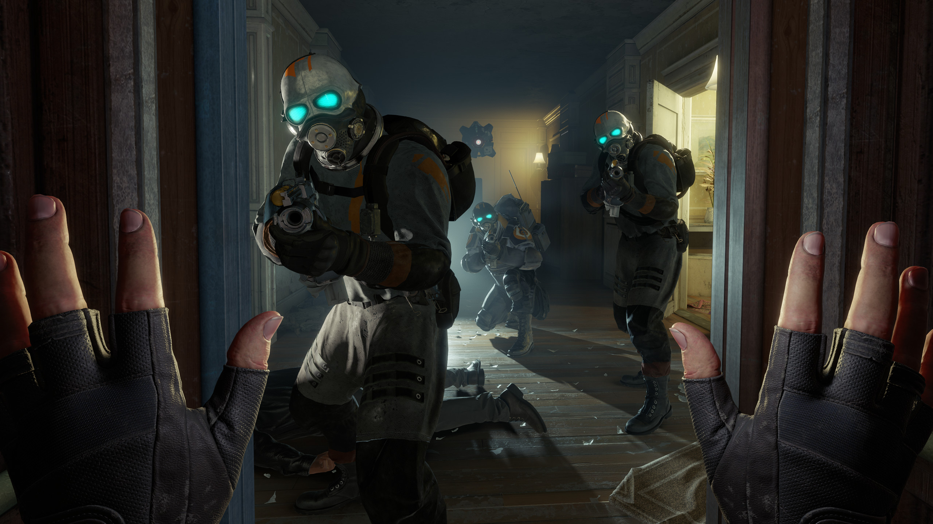
Preview of Half-Life: Alyx

Slide 21
Turning point
In 2020, Valve acknowledged that its structure had made it difficult to gather momentum, slowing their output during the 2010s.
Their VR projects and Half-Life: Alyx became a turning point, setting studio-wide short-term goals to focus the company. According to Walker, "We sort of had to collectively admit we were wrong on the premise that you will be happiest if you work on something you personally want to work on the most.”

Slide 22
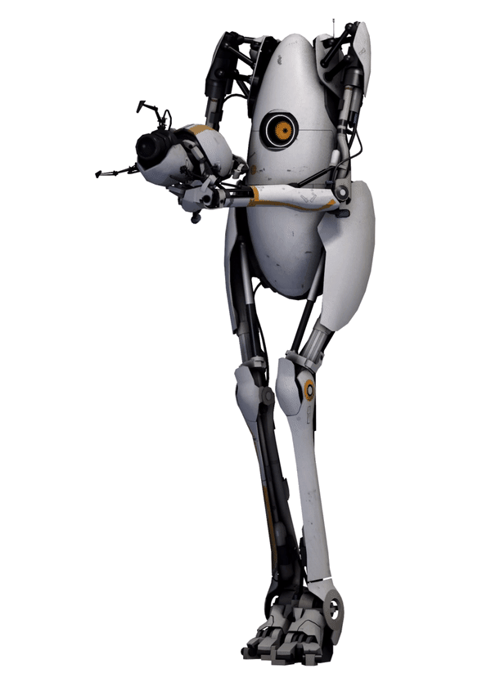
That’s it!

